Slide 1
Search & Retrieval

Slide 2
Search & Retrieval
Introduction
Background
Retrieval Algorithms
Retrieve & Re-Rank
Evaluation of Information Retrieval
Conclusion

Slide 3
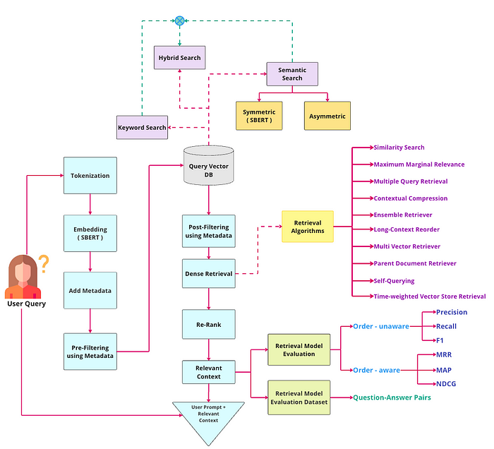
Introduction

Slide 4
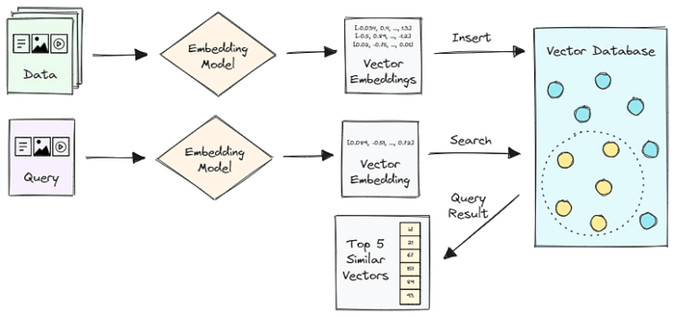
Introduction
When a user inputs a query, the process involves tokenizing the user query and performing embedding using the identical model utilized for embedding raw data. Subsequently, relevant chunks are extracted from the knowledge base, guided by their similarity to the user’s query.

Slide 5
Introduction
Let’s consider the common scenario of developing a customer support chatbot using an LLM. Usually, teams possess a wealth of product documentation, which includes a vast amount of unstructured data detailing their product, frequently asked questions, and use cases.
This data is broken down into pieces through a process called “chunking.” After the data is broken down, each chunk is assigned a unique identifier and embedded into a high-dimensional space within a vector database. This process leverages advanced natural language processing techniques to understand the context and semantic meaning of each chunk.
When a customer’s question comes in, the LLM uses a retrieval algorithm to quickly identify and fetch the most relevant chunks from the vector database. This retrieval is based on the semantic similarity between the query and the chunks, not just keyword matching.

Slide 6
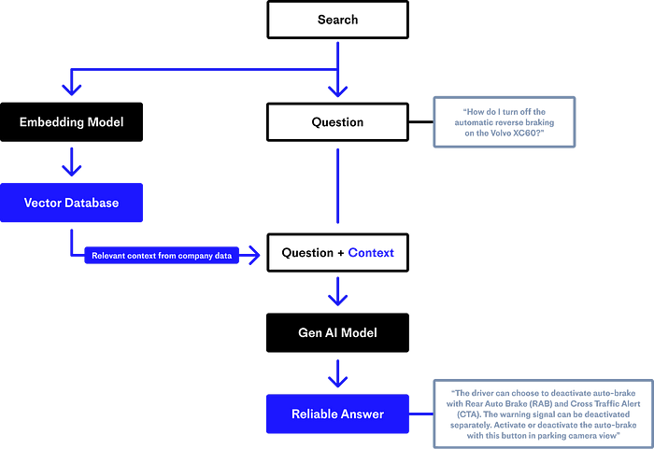
Introduction

Slide 7
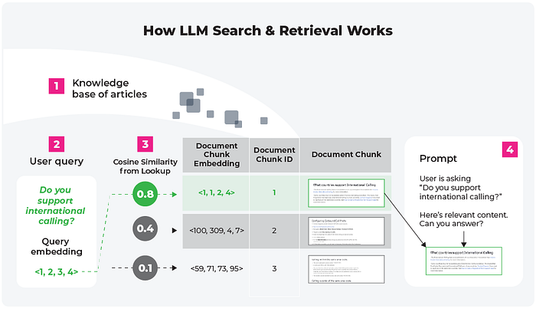
Introduction

Slide 8
Introduction
The picture above shows how search and retrieval is used with a prompt template (‘4’ in the above image) to generate a final LLM prompt context. The above view is the search and retrieval LLM use case in its simplest form: a document is broken into chunks, these chunks are embedded into a vector store, and the search and retrieval process pulls on this context to shape LLM output.
This approach offers several advantages. First, it significantly reduces the time and computational resources required for the LLM to process large amounts of data, as it only needs to interact with the relevant chunks instead of the entire documentation.
Second, it allows for real-time updates to the database. As product documentation evolves, the corresponding chunks in the vector database can be easily updated. This ensures that the chatbot always provides the most up-to-date information.
Finally, by focusing on semantically relevant chunks, the LLM can provide more precise and contextually appropriate responses, leading to improved customer satisfaction.

Slide 9
Background
Issues with Search & Retrieval
Optimizing Search & Retrieval
Types of Search
Semantic Search

Slide 10
Issues with Search & Retrieval
We While the search and retrieval method greatly enhances the efficiency and accuracy of LLMs, it’s not without potential pitfalls. Identifying these issues early can prevent them from impacting user experience.
One such challenge arises when a user inputs a query that doesn’t closely match any chunks in the vector store. The system looks for a needle in a haystack but finds no needle at all. This lack of match, often caused by unique or highly specific queries, can leave the system to draw on the “most similar” chunks available — ones that aren’t entirely relevant.
In turn, this leads to a subpar response from the LLM. Since the LLM depends on the relevance of the chunks to generate responses, the lack of an appropriate match could result in an output that’s tangentially related or even completely unrelated to the user’s query.

Slide 11
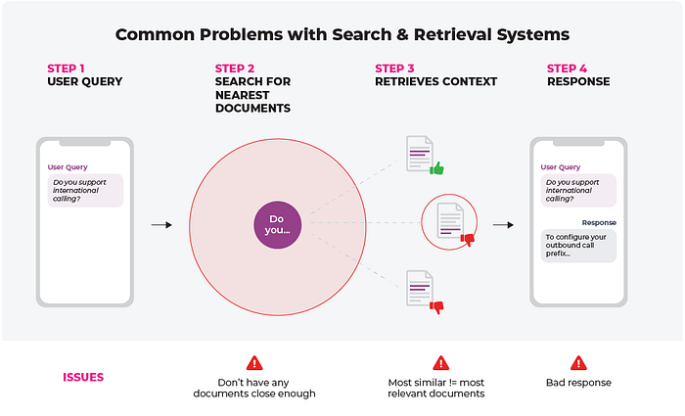
Issues with Search & Retrieval
Irrelevant or subpar responses from the LLM can frustrate users, lowering their satisfaction and ultimately causing them to lose trust in the system and product as a whole. Monitoring three main things can help prevent these issues:

Slide 12
How does a vector database work?
Query Density (Drift): Query density refers to how well user queries are covered by the vector store. If query density drifts significantly, it signals that our vector store may not be capturing the full breadth of user queries, resulting in a shortage of closely associated chunks. Regularly monitoring query density enables us to spot these gaps or shortcomings. With this insight, we can augment the vector store by incorporating more relevant chunks or refining the existing ones, improving the system’s ability to fetch data in response to user queries.
Ranking Metrics: These metrics evaluate how well the search and retrieval system is performing in terms of selecting the most relevant chunks. If the ranking metrics indicate a decline in performance, it’s a signal that the system’s ability to distinguish between relevant and irrelevant chunks might need refinement.
User Feedback: Encouraging users to provide feedback on the quality and relevance of the LLM’s responses helps gauge user satisfaction and identify areas for improvement. Regular analysis of this feedback can point out patterns and trends, which can then be used to adjust your application as necessary.

Slide 13
Optimizing Search & Retrieval
Optimization of search and retrieval processes should be a constant endeavor throughout the lifecycle of your LLM-powered application, from the building phase through to post-production.
During the building phase, attention should be given to developing a robust testing and evaluation strategy. This approach allows us to identify potential issues early on and optimize our strategies, forming a solid foundation for the system.
Key areas to focus on include:
Chunking Strategy: Evaluating how information is broken down and processed during this stage can help highlight areas for improvement in performance.
Retrieval Performance: Assessing how well the system retrieves information can indicate if we need to employ different tools or strategies, such as context ranking or HYDE.

Slide 14
Optimizing Search & Retrieval
Upon release, optimization efforts should continue as we enter the post-production phase. Even after launch, with a well-defined evaluation strategy, we can proactively identify any emerging issues and continue to improve our model’s performance. Consider approaches like:
Expanding our Knowledge Base: Adding documentation can significantly improve our system’s response quality. An expanded data set allows our LLM to provide more accurate and tailored responses.
Refining Chunking Strategy: Further modifying the way information is broken down and processed can lead to marked improvements.
Enhancing Context Understanding: Incorporating an extra ‘context evaluation’ step helps the system incorporate the most relevant context into the LLM’s response.

Slide 15
Types of Search
We have to remember that vector databases are not the panacea of search — they are very good at semantic search, but in many cases, traditional keyword search can yield more relevant results and increase user satisfaction. Why is that? It’s largely to do with the fact that ranking based on metrics like cosine similarity causes results that have a higher similarity score to appear above partial matches that may contain specific input keywords, reducing their relevance to the end user.
However, pure keyword search also has its limitations — in case the user enters a term that is semantically similar to the stored data (but is not exact), potentially useful and relevant results are not returned. As a result of this trade-off, real-world use cases for search & retrieval demand a combination of keyword and vector searches, of which vector databases form a key component (because they house the embeddings, enabling semantic similarity search and can scale to very large datasets).

Slide 16
Types of Search
To summarize the points above:
Keyword search: Finds relevant, useful results when the user knows what they’re looking for and expects results that match exact phrases in their search terms. Does not require vector databases.
Vector search: Finds relevant results when the user doesn’t know what exactly they’re looking for. Requires a vector database.
Hybrid (keyword + vector) search: Typically combines candidate results from full-text keyword and vector searches and re-ranks them using cross-encoder models. Requires both a document database and a vector database.

Slide 17
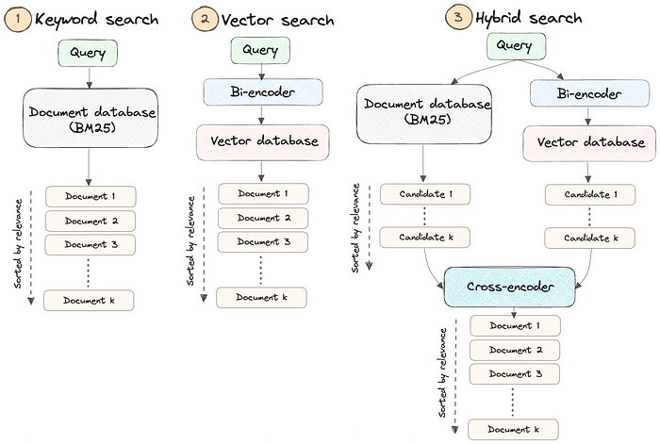
Types of Search

Slide 18
Semantic Search
Semantic search seeks to improve search accuracy by understanding the content of the search query. In contrast to traditional search engines which only find documents based on lexical matches, semantic search can also find synonyms.
Background
The idea behind semantic search is to embed all entries in our corpus, whether they be sentences, paragraphs, or documents, into a vector space.
At search time, the query is embedded into the same vector space and the closest embeddings from our corpus are found. These entries should have a high semantic overlap with the query.

Slide 19
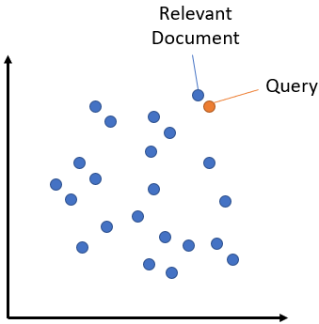
Semantic Search

Slide 20
Symmetric vs. Asymmetric Semantic Search
A critical distinction for our setup is symmetric vs. asymmetric semantic search:
For symmetric semantic search, our query and the entries in our corpus are of about the same length and have the same amount of content. An example would be searching for similar questions: Our query could for example be “How to learn Python online?” and we want to find an entry like “How to learn Python on the web?”. For symmetric tasks, we could potentially flip the query and the entries in our corpus.
For asymmetric semantic search, we usually have a short query (like a question or some keywords), and we want to find a longer paragraph answering the query. An example would be a query like “What is Python” and we wand to find the paragraph “Python is an interpreted, high-level and general-purpose programming language. Python’s design philosophy …”. For asymmetric tasks, flipping the query and the entries in our corpus usually does not make sense.

Slide 21
Retrieval Algorithms
Similarity Search (Vanilla Search) & Maximum Marginal Relevance(MMR)

Slide 22
Similarity Search (Vanilla Search) & Maximum Marginal Relevance(MMR)
When it comes to retrieving documents, the majority of methods will do a similarity metric like cosine similarity, euclidean distance, or dot product. All of these will return documents that are most similar to our query/question.
However, what if we want similar documents that are also diverse from each other? That is where Maximum Marginal Relevance (MMR) steps i.
The goal is to take into account how similar retrieved documents are to each other when determining which to return. In theory, we should have a well-rounded, diverse set of documents.

Slide 23
Similarity Search (Vanilla Search) & Maximum Marginal Relevance(MMR)
In case of unsupervised learning, let’s say our final keyPhrases are ranked like Good Product, Great Product, Nice Product, Excellent Product, Easy Install, Nice UI, Light weight etc. But there is an issue with this approach, all the phrases like good product, nice product, excellent product are similar and define the same property of the product and are ranked higher. Suppose we have a space to show just 5 key phrases, in that case, we don't want to show all these similar phrases.
We want to properly utilize this limited space such that the information displayed by the Keyphrases about the documents is diverse enough. Similar types of phrases should not dominate the whole space and users can see a variety of information about the document.

Slide 24
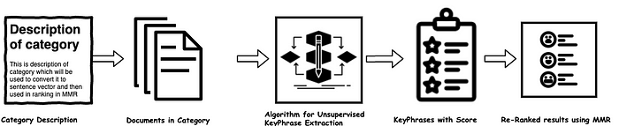
Similarity Search (Vanilla Search) & Maximum Marginal Relevance(MMR)
Remove redundant phrases using cosine similarity
Re-ranking the key phrases using MMR

Slide 25
Retrieve & Re-Rank
Retrieve & Re-Rank Pipeline
Retrieval: Bi-Encoder
Re-Ranker: Cross-Encoder
Example Scripts
Pre-trained Bi-Encoders (Retrieval)
Pre-trained Cross-Encoders (Re-Ranker)

Slide 26
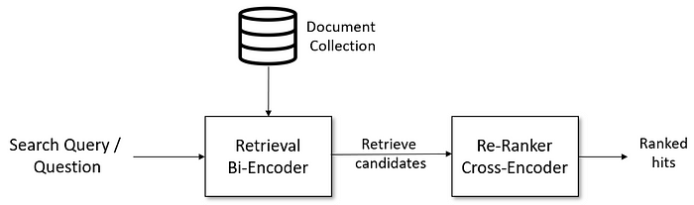
Retrieve & Re-Rank Pipeline
A pipeline for information retrieval / question-answering retrieval that works well is the following. All components are provided and explained in this article:

Slide 27
Retrieve & Re-Rank Pipeline
Given a search query, we first use a retrieval system that retrieves a large list of e.g. 100 possible hits that are potentially relevant for the query. For the retrieval, we can use either lexical search, e.g. with ElasticSearch, or we can use dense retrieval with a bi-encoder.
However, the retrieval system might retrieve documents that are not that relevant to the search query. Hence, in the second stage, we use a re-ranker based on a cross-encoder that scores the relevancy of all candidates for the given search query.

Slide 28
Retrieval: Bi-Encoder
Lexical search looks for literal matches of the query words in our document collection. It will not recognize synonyms, acronyms or spelling variations. In contrast, semantic search (or dense retrieval) encodes the search query into vector space and retrieves the document embeddings that are close in vector space.

Slide 29
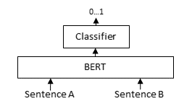
Re-Ranker: Cross-Encoder
The retriever has to be efficient for large document collections with millions of entries. However, it might return irrelevant candidates. A re-ranker based on a Cross-Encoder can substantially improve the final results for the user. The query and a possible document are passed simultaneously to the transformer network, which then outputs a single score between 0 and 1 indicating how relevant the document is for the given query.

Slide 30
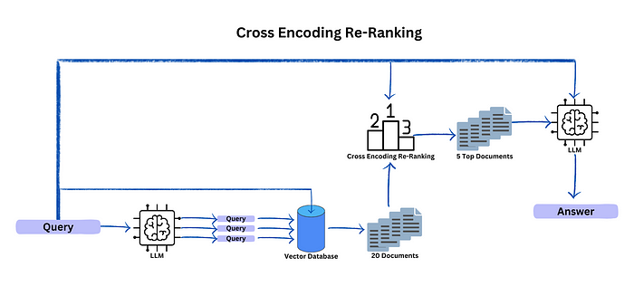
Re-Ranker: Cross-Encoder

Slide 31
Evaluation of Information Retrieval
Example
Actual vs. Predicted
Recall@K
Mean Reciprocal Rank (MRR)
Mean Average Precision (MAP)
Normalized Discounted Cumulative Gain (NDCG@K)

Slide 32
Evaluation of Information Retrieval
Evaluation of information retrieval (IR) systems is critical to making well-informed design decisions. From search to recommendations, evaluation measures are paramount to understanding what does and does not work in retrieval.
Evaluation measures for IR systems can be split into two categories: online or offline metrics.
Online metrics are captured during actual usage of the IR system when it is online. These consider user interactions like whether a user clicked on a recommended show from Netflix or if a particular link was clicked from an email advertisement (the click-through rate or CTR). There are many online metrics, but they all relate to some form of user interaction.
Offline metrics are measured in an isolated environment before deploying a new IR system. These look at whether a particular set of relevant results are returned when retrieving items with the system.

Slide 33
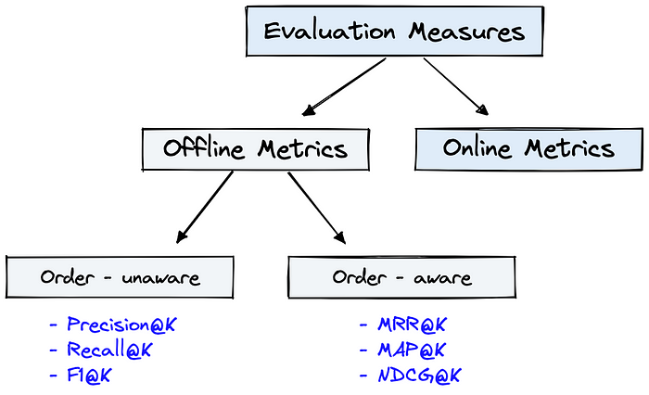
Evaluation of Information Retrieval
Evaluation measures can be categorized as either offline or online metrics. Offline metrics can be further divided into order-unaware or order-aware, which we will explain soon.
Organizations often use both offline and online metrics to measure the performance of their IR systems. It begins, however, with offline metrics to predict the system’s performance before deployment.

Slide 34
Euclidean Distance
We will focus on the most useful and popular offline metrics:
Recall@K
Mean Reciprocal Rank (MRR)
Mean Average Precision@K (MAP@K)
Normalized Discounted Cumulative Gain (NDCG@K)
These metrics are deceptively simple yet provide invaluable insight into the performance of IR systems.
We can use one or more of these metrics in different evaluation stages. During the development of Spotify’s podcast search; Recall@K (using K=1) was used during training on “evaluation batches”, and after training, both Recall@K and MRR (using K=30) were used with a much larger evaluation set.
For now, understand that Spotify was able to predict system performance before deploying anything to customers. This allowed them to deploy successful A/B tests and significantly increase podcast engagement.
We have two more subdivisions for these metrics; order-aware and order-unaware. This refers to whether the order of results impacts the metric score. If so, the metric is order-aware. Otherwise, it is order-unaware.

Slide 35
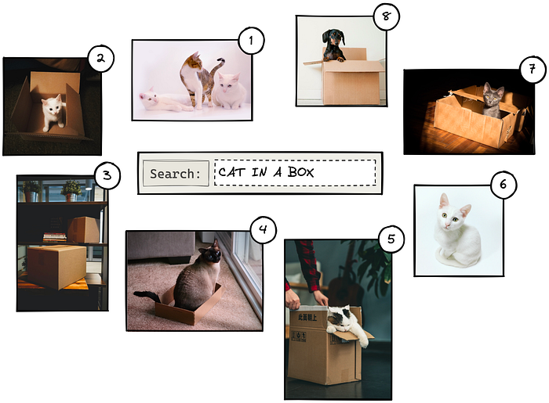
Example
Throughout the article, we will be using a very small dataset of eight images. In reality, this number is likely to be millions or more.

Slide 36
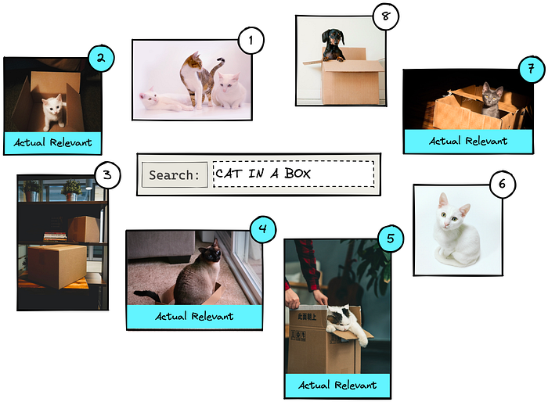
Example
If we were to search for “cat in a box”, we may return something like the above. The numbers represent the relevance rank of each image as predicted by the IR system. Other queries would yield a different order of results.
We can see that results 2, 4, 5, and 7 are actual relevant results. The other results are not relevant as they show cats without boxes, boxes without cats, or a dog.

Slide 37
Actual vs. Predicted
When evaluating the performance of the IR system, we will be comparing actual vs. predicted conditions, where:
Actual condition refers to the true label of every item in the dataset. These are positive (p) if an item is relevant to a query or negative (n) if an item is irrelevant to a query.
Predicted condition is the predicted label returned by the IR system. If an item is returned, it is predicted as being positive (p^ ) and, if it is not returned, is predicted as a negative (n^).
From these actual and predicted conditions, we create a set of outputs from which we calculate all of our offline metrics. Those are the true/false positives and true/false negatives.
The positive results focus on what the IR system returns. Given our dataset, we ask the IR system to return two items using the “cat in a box” query. If it returns an actual relevant result this is a true positive (pp^ ); if it returns an irrelevant result, we have a false positive (np^ ).

Slide 38
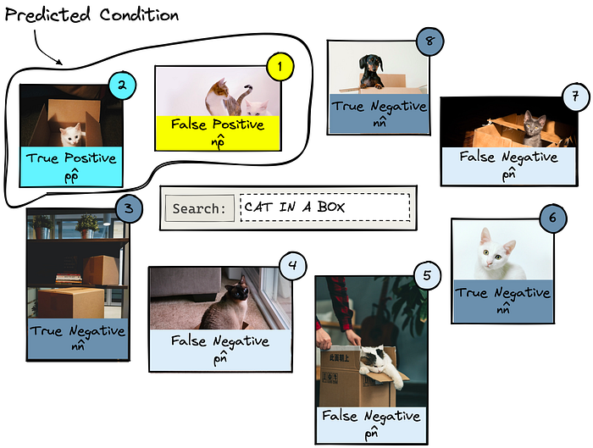
Actual vs. Predicted
For negative results, we must look at what the IR system does not return. Let’s query for two results. Anything that is relevant but is not returned is a false negative (pn^). Irrelevant items that were not returned are true negatives (nn^).

Slide 39
Actual vs. Predicted
The filtering process can be performed either before or after the vector search itself, but each approach has its challenges that may impact the query performance:
Pre-filtering: In this approach, metadata filtering is done before the vector search. While this can help reduce the search space, it may also cause the system to overlook relevant results that don’t match the metadata filter criteria. Additionally, extensive metadata filtering may slow down the query process due to the added computational overhead.
Post-filtering: In this approach, the metadata filtering is done after the vector search. This can help ensure that all relevant results are considered, but it may also introduce additional overhead and slow down the query process as irrelevant results need to be filtered out after the search is complete.
To optimize the filtering process, vector databases use various techniques, such as leveraging advanced indexing methods for metadata or using parallel processing to speed up the filtering tasks. Balancing the trade-offs between search performance and filtering accuracy is essential for providing efficient and relevant query results in vector databases.

Slide 40
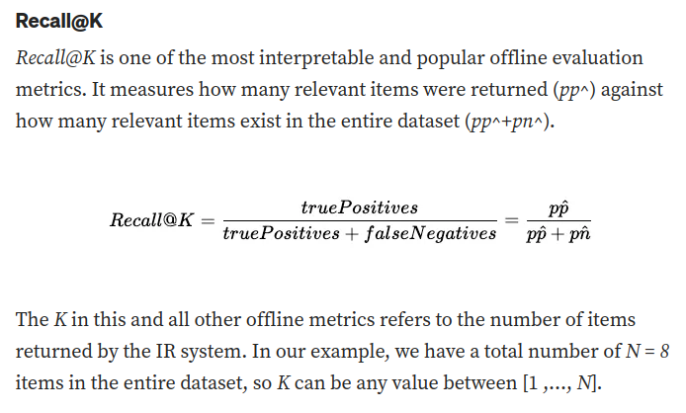
Actual vs. Predicted

Slide 41
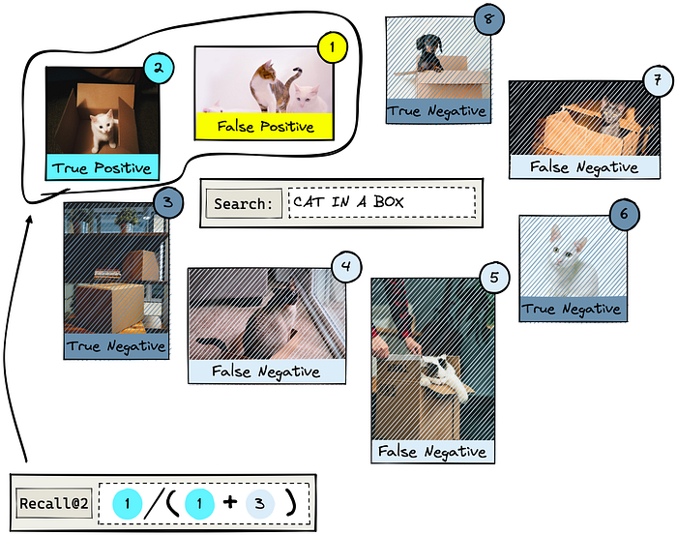
Actual vs. Predicted

Slide 42
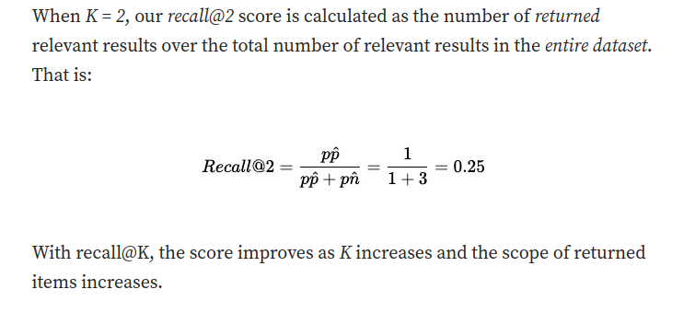
Actual vs. Predicted

Slide 43
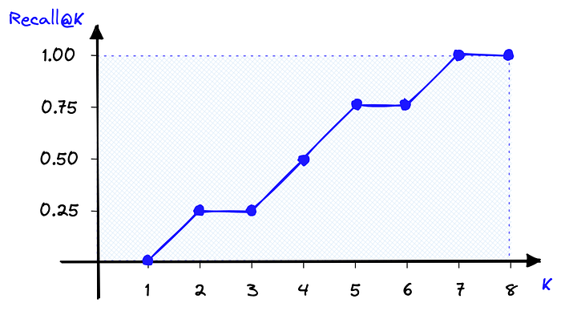
Actual vs. Predicted

Slide 44
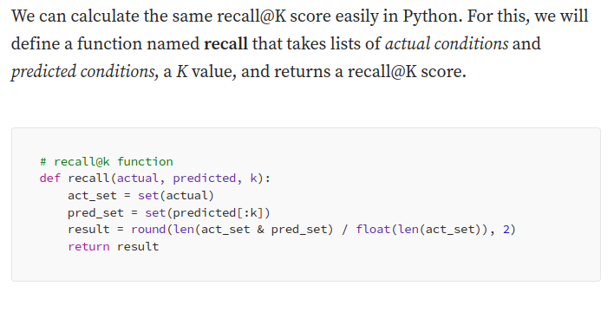
Actual vs. Predicted

Slide 45
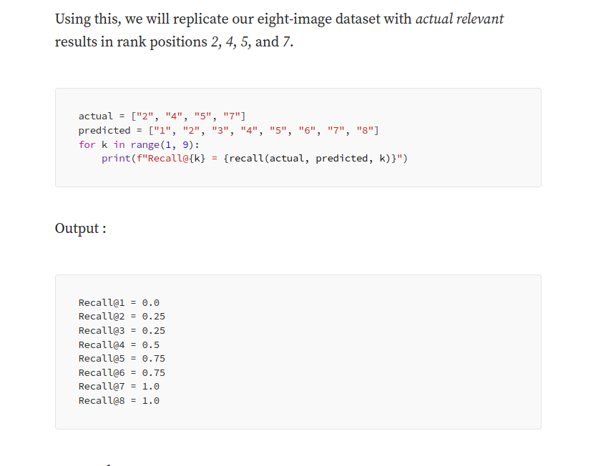
Actual vs. Predicted

Slide 46
Pros and Cons
Recall@K is undoubtedly one of the most easily interpretable evaluation metrics. We know that a perfect score indicates that all relevant items are being returned. We also know that a smaller k value makes it harder for the IR system to score well with recall@K.
Still, there are disadvantages to using recall@K. By increasing K to N or near N, we can return a perfect score every time, so relying solely on recall@K can be deceptive.
Another problem is that it is an order-unaware metric. That means if we used recall@4 and returned one relevant result at rank one, we would score the same as if we returned the same result at rank four. Clearly, it is better to return the actual relevant result at a higher rank, but recall@K cannot account for this.

Slide 47
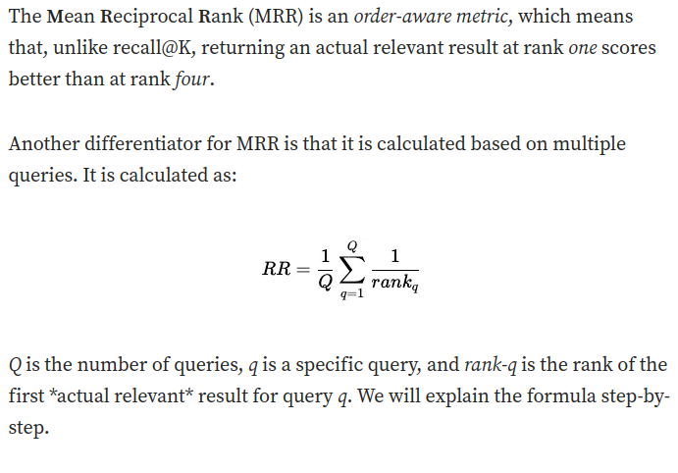
Mean Reciprocal Rank (MRR)

Slide 48
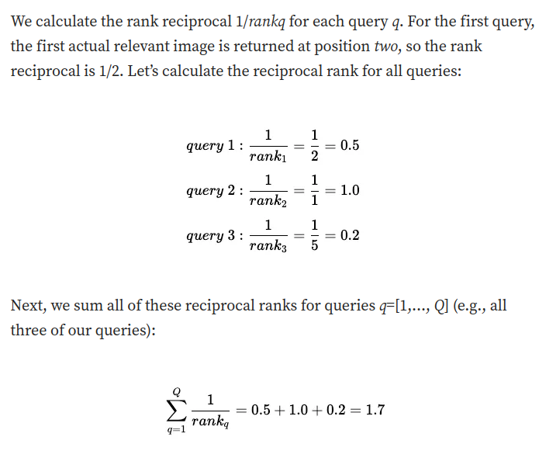
Mean Reciprocal Rank (MRR)

Slide 49
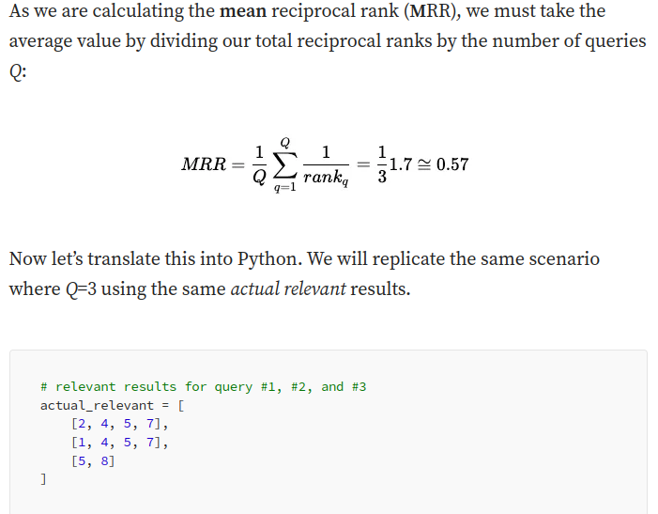
Mean Reciprocal Rank (MRR)

Slide 50
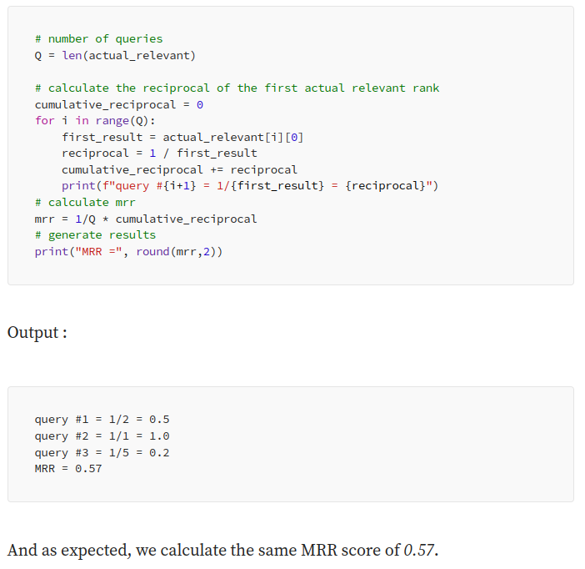
Mean Reciprocal Rank (MRR)

Slide 51
Pros and Cons
MRR has its own unique set of advantages and disadvantages. It is order-aware, a massive advantage for use cases where the rank of the first relevant result is important, like chatbots or question-answering.
On the other hand, we consider the rank of the first relevant item, but no others. That means for use cases where we’d like to return multiple items like recommendations or search engines, MRR is not a good metric. For example, if we’d like to recommend ~10 products to a user, we ask the IR system to retrieve 10 items. We could return just one actual relevant item in rank one and no other relevant items. Nine of ten irrelevant items is a terrible result, but MRR would score a perfect 1.0.
Another minor disadvantage is that MRR is less readily interpretable compared to a simpler metric like recall@K. However, it is still more interpretable than many other evaluation metrics.

Slide 52
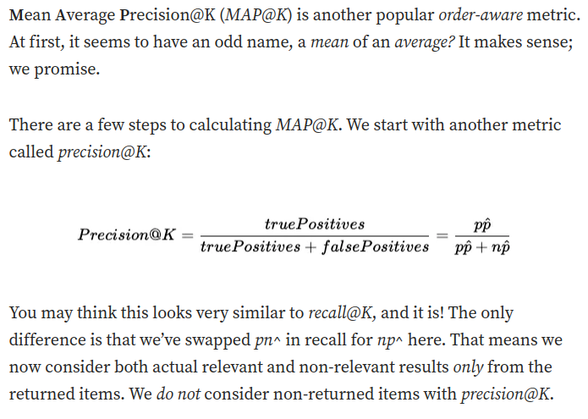
Mean Average Precision (MAP)

Slide 53
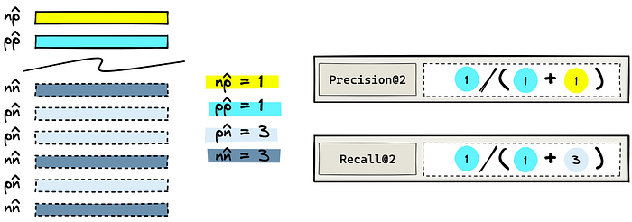
Mean Average Precision (MAP)

Slide 54
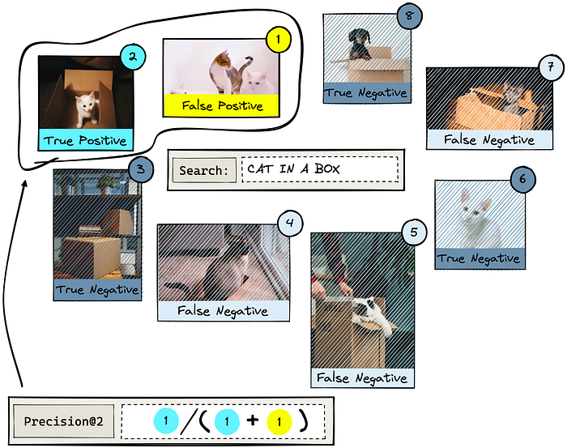
Mean Average Precision (MAP)
Let’s return to the “cat in a box” example. We will return �=2K=2 items and calculate precision@2.

Slide 55
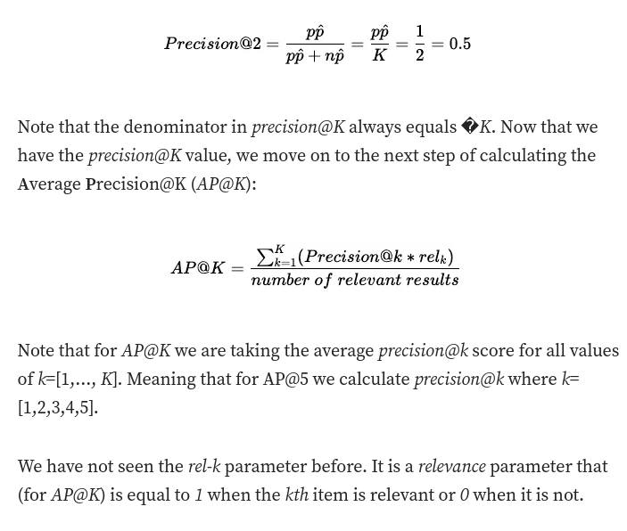
Mean Average Precision (MAP)

Slide 56
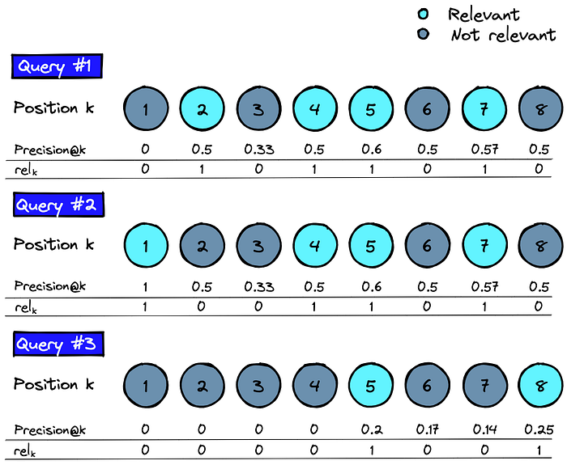
Mean Average Precision (MAP)

Slide 57
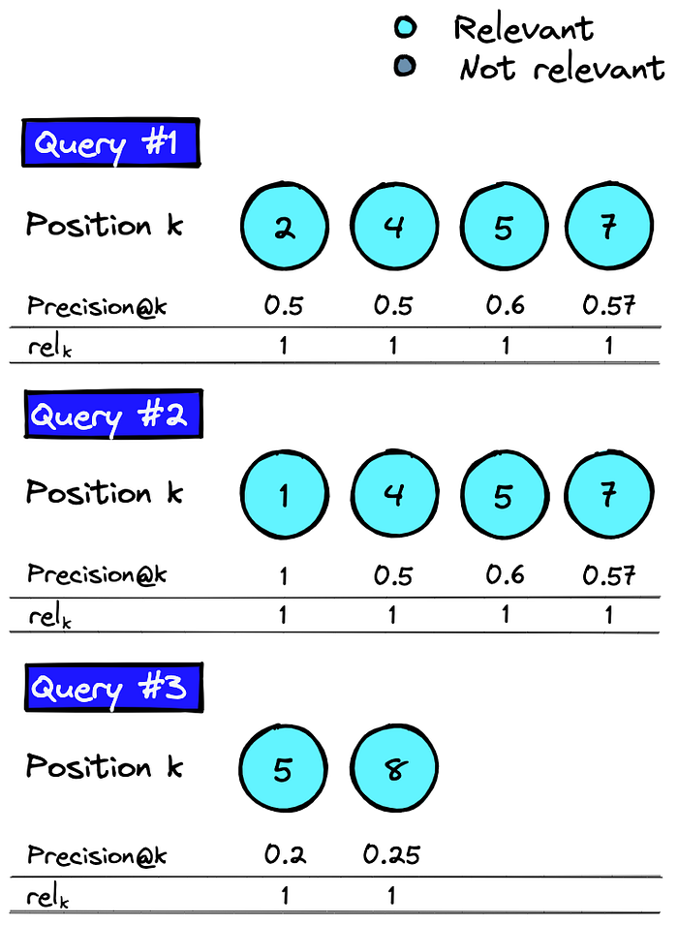
Mean Average Precision (MAP)
We calculate precision@k and rel-k​ iteratively using k=[1,…,K].
As we multiply precision@k and rel-k​, we only need to consider precision@k where the kth item is relevant.

Slide 58
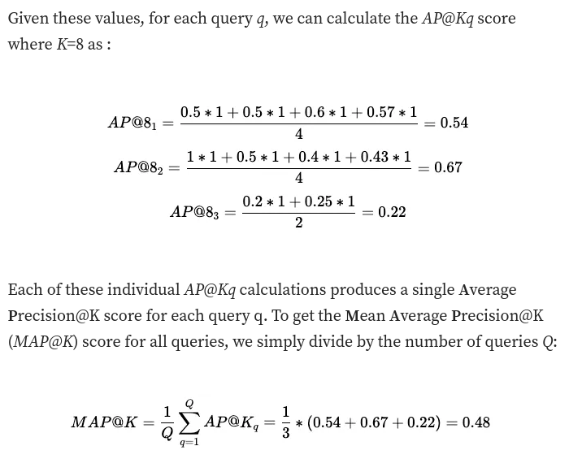
Mean Average Precision (MAP)

Slide 59
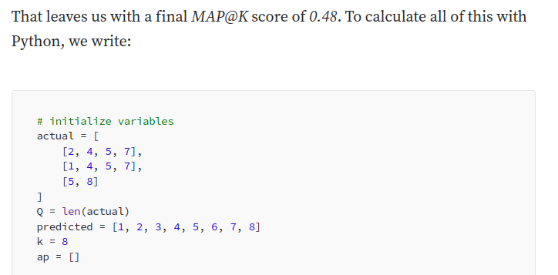
Mean Average Precision (MAP)

Slide 60
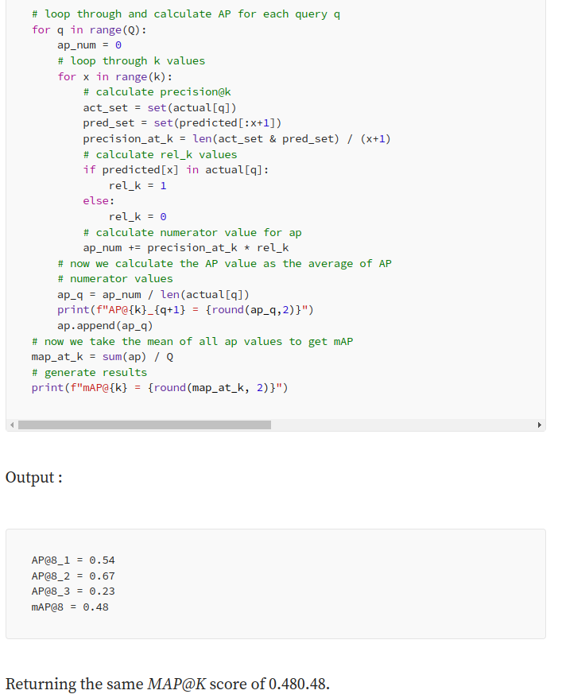
Mean Average Precision (MAP)

Slide 61
Pros and Cons
MAP@K is a simple offline metric that allows us to consider the order of returned items. Making this ideal for use cases where we expect to return multiple relevant items.
The primary disadvantage of MAP@K is the rel-K relevance parameter is binary. We must either view items as relevant or irrelevant. It does not allow for items to be slightly more/less relevant than others.

Slide 62
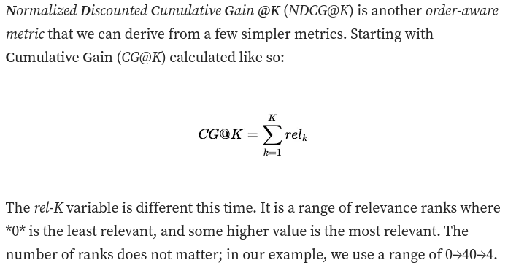
Normalized Discounted Cumulative Gain (NDCG@K)

Slide 63
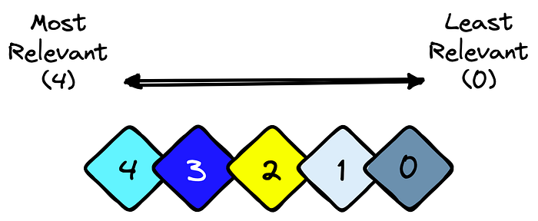
Normalized Discounted Cumulative Gain (NDCG@K)

Slide 64
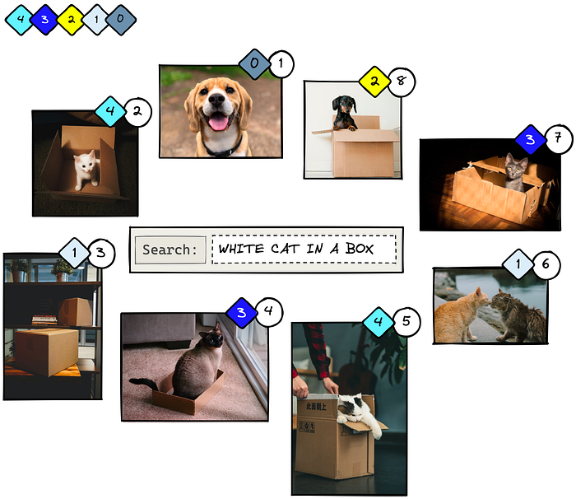
Normalized Discounted Cumulative Gain (NDCG@K)
Let’s try applying this to another example. We will use a similar eight-image dataset as before. The circled numbers represent the IR system’s predicted ranking, and the diamond shapes represent the ����relk actual ranking.

Slide 65
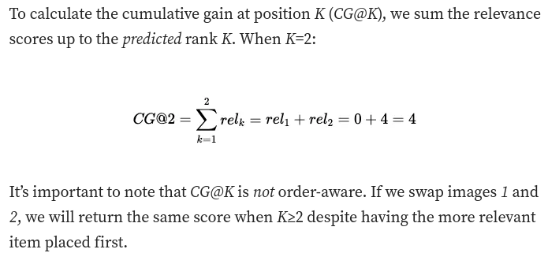
Normalized Discounted Cumulative Gain (NDCG@K)

Slide 66
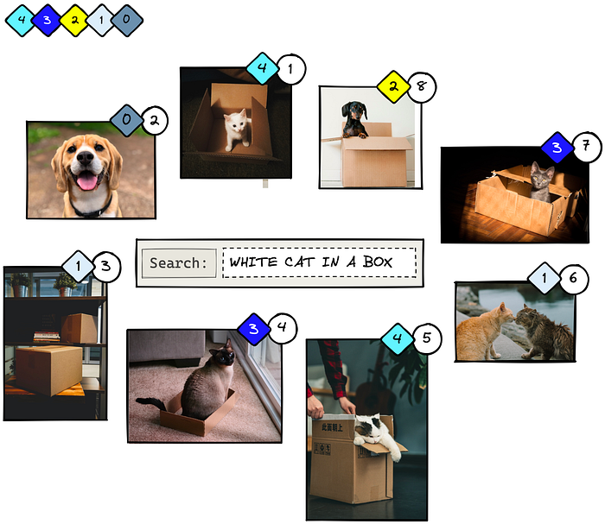
Normalized Discounted Cumulative Gain (NDCG@K)

Slide 67
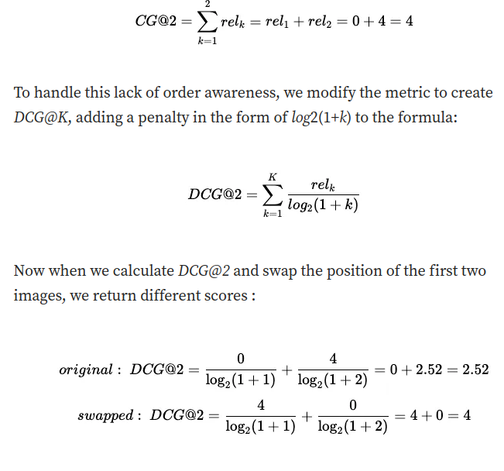
Normalized Discounted Cumulative Gain (NDCG@K)

Slide 68
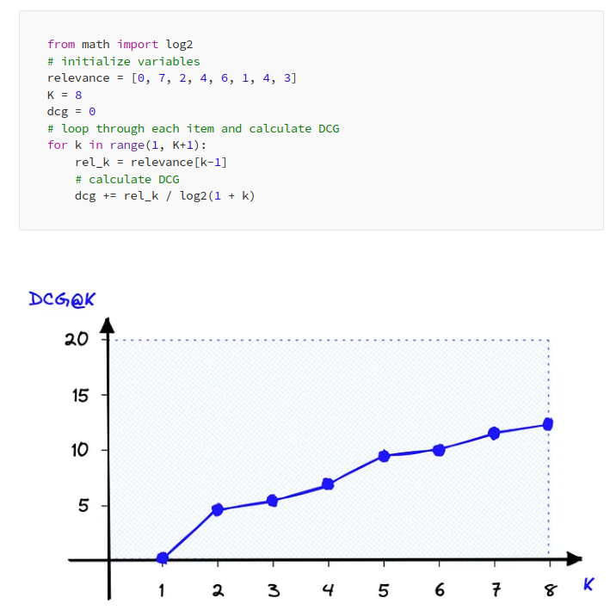
Normalized Discounted Cumulative Gain (NDCG@K)

Slide 69
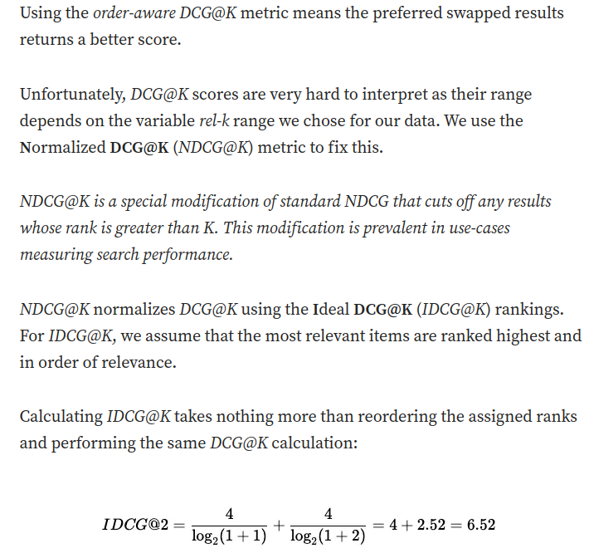
Normalized Discounted Cumulative Gain (NDCG@K)

Slide 70
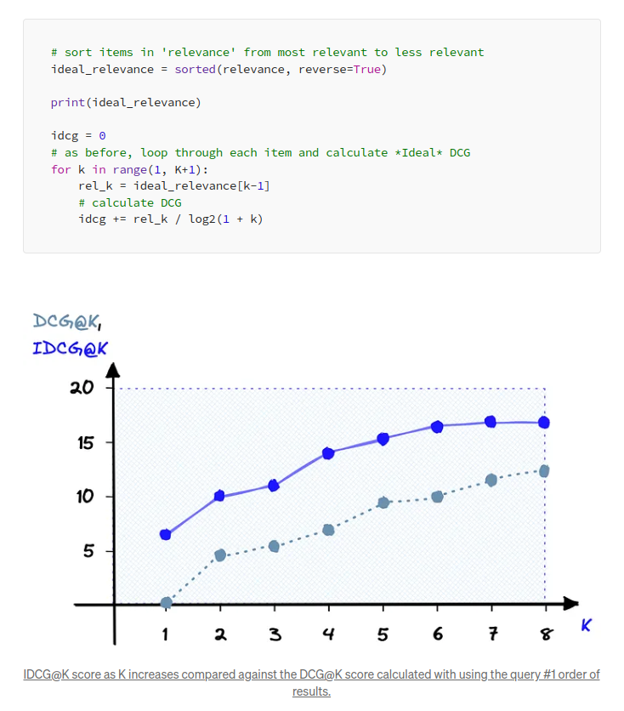
Normalized Discounted Cumulative Gain (NDCG@K)

Slide 71
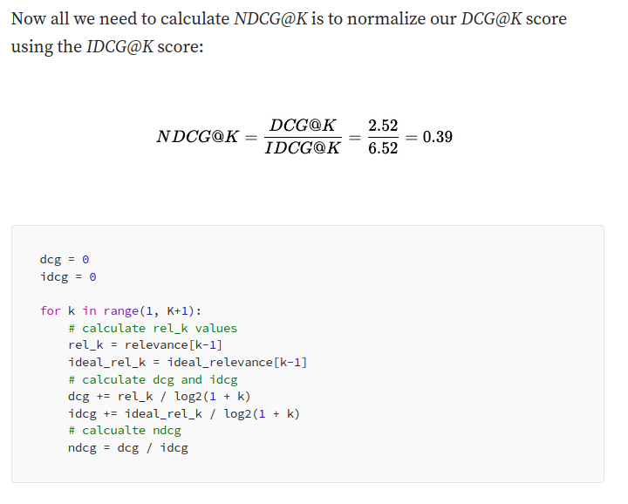
Normalized Discounted Cumulative Gain (NDCG@K)

Slide 72
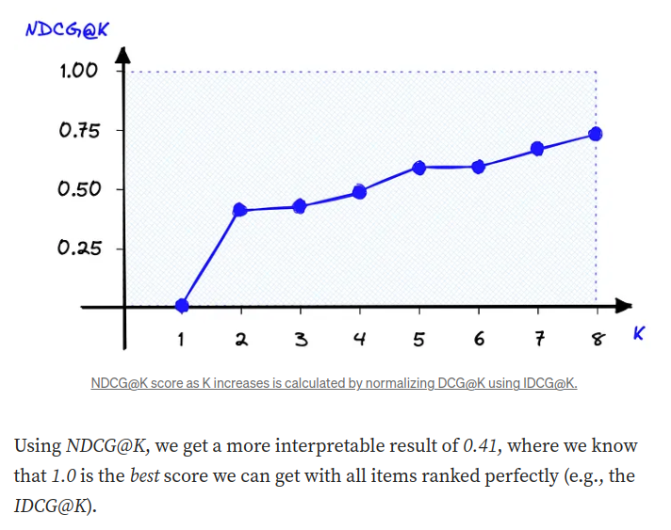
Normalized Discounted Cumulative Gain (NDCG@K)

Slide 73
Pros and Cons
NDCG@K is one of the most popular offline metrics for evaluating IR systems, in particular web search engines. That is because NDCG@K optimizes for highly relevant documents, is order-aware, and is easily interpretable.
However, there is a significant disadvantage to NDCG@K. Not only do we need to know which items are relevant for a particular query, but we need to know whether each item is more/less relevant than other items; the data requirements are more complex.
These are some of the most popular offline metrics for evaluating information retrieval systems. A single metric can be a good indicator of system performance. For even more confidence in retrieval performance, we can use several metrics, just as Spotify did with recall@1, recall@30, and MRR@30.

Slide 74
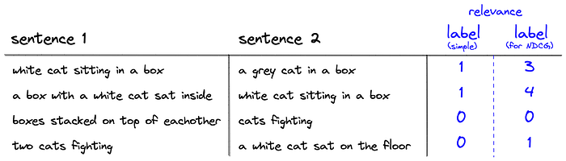
Pros and Cons
These metrics are still best supported with online metrics during A/B testing, which acts as the next step before deploying our retrieval system to the world. However, these offline metrics are the foundation behind any retrieval project.
Whether we’re prototyping our very first product, or evaluating the latest iteration of Google search, evaluating our retrieval system with these metrics will help us deploy the best retrieval system possible.

Slide 75
Conclusions
We explored the search process in the Retrieval Augmented Generation (RAG) application, emphasizing semantic search using vector databases. It highlights advantages such as reduced processing time and real-time updates. Challenges include subpar responses to unique queries. Strategies to prevent issues involve monitoring query density and user feedback. Optimization efforts should focus on the building and post-production phases, including expanding the knowledge base. The blog also discusses types of search, semantic search, and a retrieve & re-rank pipeline. Pre-trained models and offline evaluation metrics like Recall@K are recommended. Overall, it emphasizes the need for continuous optimization and thorough evaluation in RAG applications.

